Slide 1

DETAILS :
Name : Madhusri Chodavarapu
Skills Build Email ID: chmadhusri455@gmail.com
College Name: ACE Engineering College, Ghatkesar
College State: Telangana
Internship Domain: Cyber Security
Internship Start and End Dates: 13-10-2023 to 26-11-2023
Notes:
Photo by Nastuh Abootalebi on Unsplash

Slide 2


PROBLEM STATEMENT/PROJECT TOPIC :
HIDING MESSAGE IN AN IMAGE
USING STEGANOGRAPHY
Notes:
Photo by Dylan Gillis on Unsplash

Slide 3
AGENDA :
________________________________________________________________
Hiding a message in an image
. Introduction
. Why Should We Use Steganography?
. A Peek into the Problem Statement
. Implementation of Steganography in Python
. Benefits of Steganography
. Disadvantages of Steganography
__________________________
__________________________

Slide 4

Objectives :
To Understand the basics of steganography
To Get familiar with steganography tools and software
To Understand the role of steganography in security and privacy
To develop the skills and to apply steganography in real-world scenarios
To understand the limitations and risks of steganography

Slide 5

Introduction to Steganography:
__________________________
__________________________
Definition: Steganography is the ancient art, now prevalent in the digital age, of covertly embedding information within seemingly innocuous carriers.
Etymology: The term "steganography" originates from the Greek words "steganos" (covered) and "graphy" (writing).
Objective: Unlike cryptography, which focuses on securing content through encryption, steganography aims to hide the very existence of a message.
Digital Realm: In the digital domain, steganography often involves concealing data within images, audio files, or text.
Applications: Steganography finds applications in secure communication, digital watermarking, and copyright protection.
Evolution in Security: As an integral part of information security, steganography contributes to the ever-evolving landscape of securing digital communication.
Hiding a message in an image

Slide 6

Why Should We Use Steganography :
__________________________
__________________________
Hiding a message in an image
Steganography is like a secret language for messages. It hides information in regular things like pictures or sounds. This sneaky method keeps messages safe because it doesn't attract attention like normal passwords do. It's helpful when you want to send secret stuff without others knowing. Also, in pictures and sounds, steganography helps protect them from being used without permission. It's like a secret code within a code. Even if the first code (encryption) is broken, the secret code (steganography) keeps things safe. This trick is useful for the military too, helping them talk quietly in a noisy world.
Notes:
Photo by Dylan Gillis on Unsplash

Slide 7

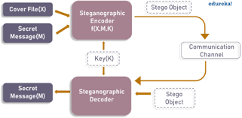
Problem Statements :
___________________________________________________________
___________________________________________________________
Hiding a message in an image
A problem statement in steganography refers to the specific challenge or requirement the steganographer is trying to solve. Some common problem statements include:
Concealing the Existence of a Message
Concealing the Existence of a Message From Specific Individuals or Groups
Concealing the Existence of a Message and Providing a Level of Security
Hiding Multiple Messages in a Single File
Hiding a Message Such That it can be Retrieved in Multiple Way
Hiding a Message in a way that it can be Retrieved in a Specific Sequence
Notes:
Photo by airfocus on Unsplash

Slide 8




Benefits of Steganography :
Confidentiality
Covert Communication
Copyright Protection
Anonymity
Security Enhancement
Reduced Visibility
Evasion
Covert Exchange
Tamper Detection
Notes:
Photo by Nastuh Abootalebi on Unsplash

Slide 9

DISADVANTAGES of STEGANOGRAPHY :
Hard to Detect:
Detecting hidden information is challenging, making it difficult to identify potential threats or misuse.
Potential for Misuse:
Steganography can be used for malicious purposes, hiding harmful content within innocent-looking files.
Limited Capacity:
There's a limit to how much information can be hidden in a file, which can be a drawback for certain applications.
Data Integrity Concerns:
Embedding information may alter the original file, impacting its integrity and usability.
Key Management Challenges:
Securing and managing encryption keys is crucial; if compromised, hidden data becomes vulnerable.

Slide 10

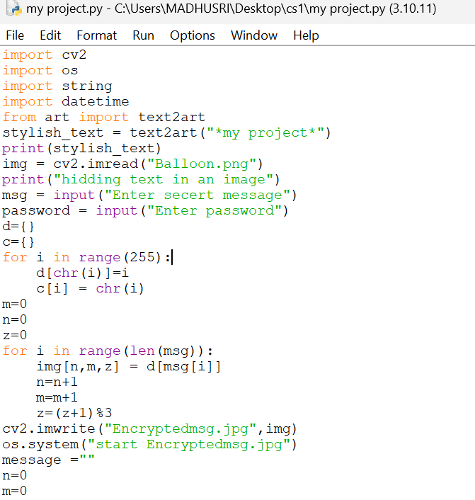
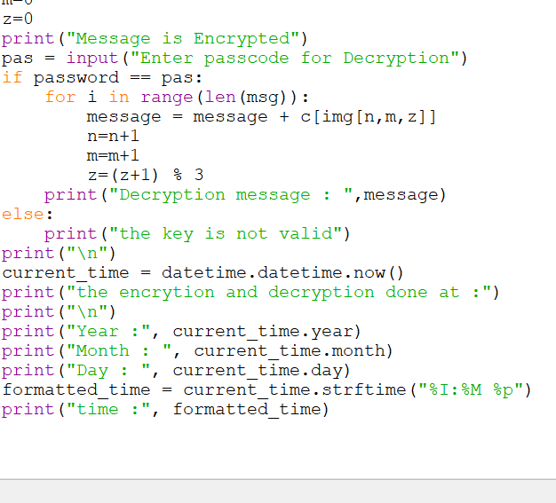


CODE PROCESS :
https://github.com/Madhusri-12it/aicte-b3-project-cs-
PROJECT LINK :
Notes:
Photo by Copernico on Unsplash

Slide 11




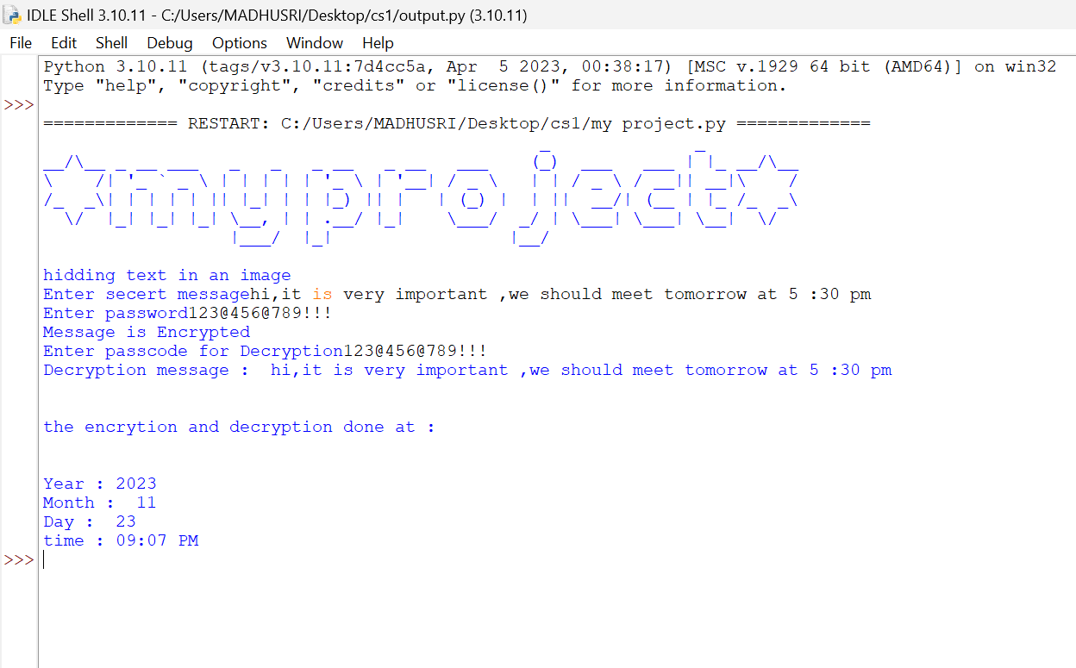
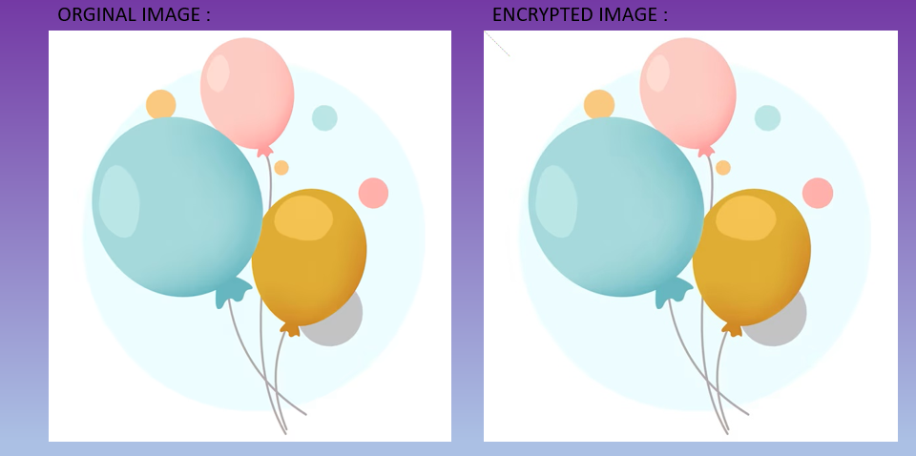
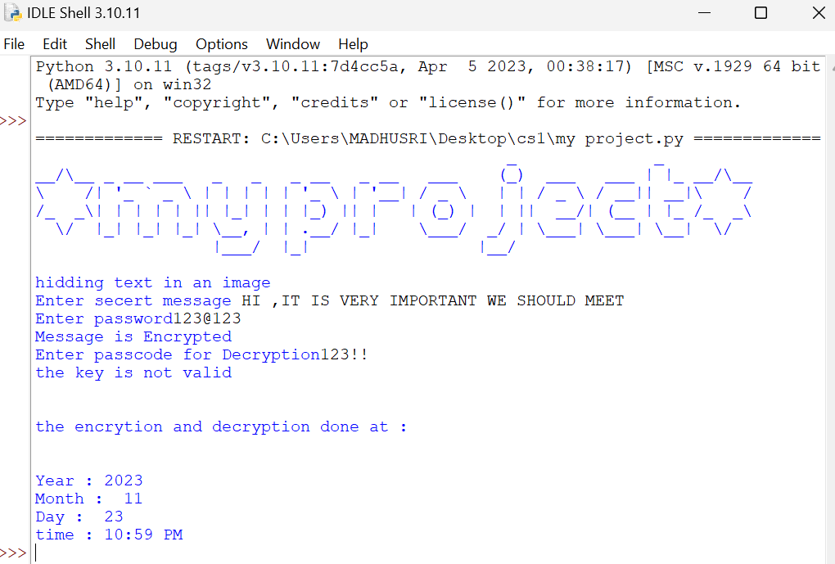
Encryption and Decryption Process :
Notes:
Photo by Dell on Unsplash

Slide 12


Conclusion :
The Technique of hiding messages within images, commonly known as steganography, emerges as an elegant solution for secure communication. This method seamlessly embeds information within the pixels of an image, providing a discreet and creative avenue for data transfer. The evolution of image-based steganography techniques mirrors the continual progress in technology, presenting a dynamic and innovative landscape for users. It's worth appreciating the potential applications of this method in safeguarding sensitive information and fostering privacy-conscious communication.
Yet, it is vital to approach this technology with a sense of responsibility and ethical awareness. The potential for misuse, including concerns related to cybersecurity and law enforcement, necessitates a thoughtful and balanced perspective. By promoting responsible use and staying mindful of ethical considerations, we can fully embrace the positive aspects of image-based steganography, ensuring it remains a valuable asset for privacy-conscious individuals and organizations in the ever-evolving digital landscape.
Notes:
Photo by nrd on Unsplash

Slide 13


Thank you.
Notes:
Photo by Nastuh Abootalebi on Unsplash

